Slide 1

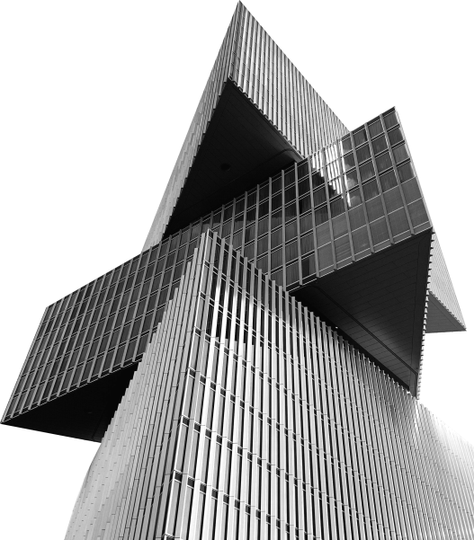
ANTIX
shenzhenANTIX
Contact ANTIX to create your solution
Technology co., Ltd
Precision solutions for all displays
OUTDOOR | INDOOR | FLEXIBLE
We tailor modules to your unique specs

Slide 2


01 02 |  |  | 03 04 05 06
Dual |  | Flexible | GOB LED | COB LED |  | Indoor LED |  | Outdoor
Service LED Module |  | LED Module | Module | Module |  | Module |  | LED Module PART 06
PART 01 |  | PART 02 | PART 03 | PART 04 |  | PART 05

Slide 3
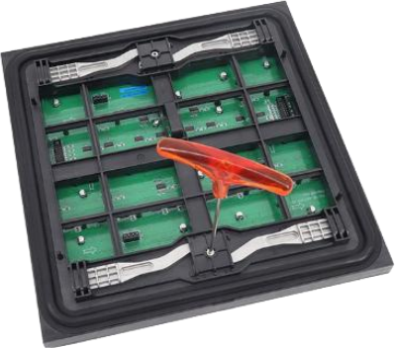

ANTIX
Dual Service LED Module
01
PART ONE

Slide 4
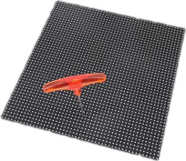
Front And Rear Service 01
LED Display Module
01 HIGH REFRESH RATE
02 SMD 3 in 1
03 2 YEARS WARRANTY

Slide 5

Dual Service LED 01
Screen Panel
The front and rear service LED module can be replaced or taken out from the front side or real side easily by only one person . No screws design, so it is easier to mount the modules on the cabinet quickly.
Dual-mode
maintenance (Front
& Rear) outdoor LED
display panel ,
saving the
maintenance space
and being compatible
with hard installation
conditions.
W e c h o o s e h i g h quality L E D c hi ps such as Nationstar, Kinglight for outdoor front& rear service L E D m o d u l e s , ensuring high refresh rate w it h t he best color uniformity.
Adopting high reliable
SMD1921, SMD2727
and SMD3535 to
ensure outdoor
front&rear access
LED modules perform
high brightness from
5500 – 7500 CD/㎡ .
LED Chips
SMD 3 in 1 LED
Easy Assembling
Dual-mode Maintenancm

Slide 6







320x320mm Dual Service (Frontal & Rear) 01 Outdoor LED Module
Model | LED Type | Module Size （MM） | Module Resolution | Driving Mode | Refresh Rate(Hz) | Brightness(Nits)
P4 | SMD1921 | 320*320 | 80*80 | 1/ 10 | 3840 | 5500
P5 | SMD1921 | 320*320 | 64*64 | 1/8 | 3840 | 5000
P5.33 | SMD1921 | 320*320 | 60*60 | 1/8 | 3840 | 5000
P6.67 | SMD2727 | 320*320 | 48*48 | 1/6 | 3840 | 5500
P8 | SMD3535 | 320*320 | 40*40 | 1/5 | 3840 | 5000
P10 | SMD3535 | 320*320 | 32*32 | 1/2 | 3840 | 6000
P10-DIP | DIP346 | 320*320 | 32*32 | 1/4 | 3840 | 9000

Slide 7
250x250mm Dual Service (Frontal & Rear) 01 Outdoor LED Module
Model | LED Type | Module Size （MM） | Module Resolution | Driving Mode | Refresh Rate(Hz) | Brightness(Nits)
P3.12 | SMD1415 | 250*250 | 80*80 | 1/ 10 | 3840 | 6500
P3.91 | SMD1921 | 250*250 | 64*64 | 1/8 | 3840 | 6000
P4.81 | SMD1921 | 250*250 | 52*52 | 1/6 | 3840 | 5500
P5.95 | SMD2727 | 250*250 | 42*42 | 1/7 | 3840 | 6000
P6.94 | SMD2727 | 250*250 | 36*36 | 1/6 | 3840 | 6000
P8.33 | SMD3535 | 250*250 | 30*30 | 1/5 | 3840 | 6000
P10.41 | SMD3535 | 250*250 | 24*24 | 1/2 | 3840 | 6000

Slide 8
320x160mm Dual Service (Frontal & Rear) 01 Outdoor LED Module
Model | LED Type | Module Size （MM） | Module Resolution | Driving Mode | Refresh Rate(Hz) | Brightness(Nits)
P3.07 | SMD1415 | 320*160 | 104*52 | 1/13 | 3840 | 5500
P4 | SMD1921 | 320*160 | 80*40 | 1/ 10 | 3840 | 5500
P5 | SMD1921 | 320*160 | 64*32 | 1/8 | 3840 | 5500
P6.67 | SMD2727 | 320*160 | 48*24 | 1/6 | 3840 | 5500
P8 | SMD2727 | 320*160 | 40*20 | 1/5 | 3840 | 5000
P10 | SMD2727 | 320*160 | 32* 16 | 1/2 | 3840 | 6000

Slide 9
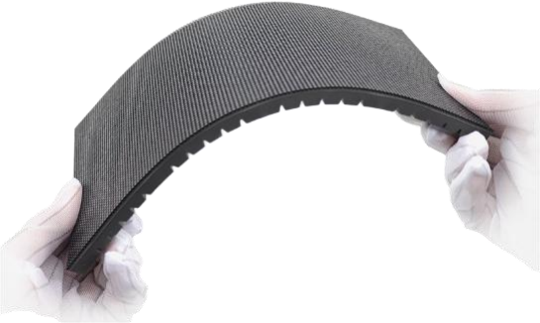
ANTIX
Flexible LED
Module
02
PART T O

Slide 10
Flexible Soft LED 02
Display Module
The main feature of Flexible LED Screen Panel is that the LED panel is soft, flexible.
Compare to indoor fixed LED display and outdoor fixed LED display, the flexible LED panel can be any designed forrolled, bend and swing to do any shape LED video wall as you want.
Super flexible Soft LED display module with high-quality driving IC and LEDs with high refresh rate and
great color uniformity.
We offer various pixels for flexible LED panel ranges from P1.875mm, P2mm, P3mm, P4mm to P5mm.
The panel sizes can be 240*120mm, 320mm* 160mm and 256*128mm.

Slide 11







240x120mm Series Flexible Soft LED LED 02
Display Module
Model | LED Type | Module Size （MM） | Module Resolution | Driving Mode | Refresh Rate(Hz) | Brightness(Nits)
P0.9 | COB | 240*120 | 256*128 | 1/64 | 3840 | 800
P0.9 | IMD-M09 | 240*120 | 256*128 | 1/64 | 3840 | 650
P1.25 | SMD1010 | 240*120 | 192*96 | 1/48 | 3840 | 650
P1.579 | SMD1212 | 240*120 | 152*76 | 1/38 | 3840 | 700
P1.875 | SMD1515 | 240*120 | 128*64 | 1/32 | 3840 | 700
P2 | SMD1515 | 240*120 | 120*60 | 1/30 | 3840 | 700
P2.5 | SMD1515 | 240*120 | 96*48 | 1/24 | 3840 | 700
P3 | SMD2020 | 240*120 | 80*40 | 1/20 | 3840 | 650
P4 | SMD2020 | 240*120 | 60*30 | 1/ 15 | 3840 | 650

Slide 12







320x160mm Series Flexible Soft LED 02
Screen Module
Model | LED Type | Module Size （MM） | Module Resolution | Driving Mode | Refresh Rate(Hz) | Brightness(Nits)
P1.25 | SMD1010 | 320*160 | 256*128 | 1/64 | 3840 | 600
P1.29 | SMD1010 | 320*160 | 248*124 | 1/62 | 3840 | 600
P1.53 | SMD1212 | 320*160 | 208*104 | 1/52 | 3840 | 600
P1.56 | SMD1212 | 320*160 | 204* 102 | 1/51 | 3840 | 600
P1.86 | SMD1212 | 320*160 | 172*86 | 1/43 | 3840 | 600
P2 | SMD1515 | 320*160 | 160*80 | 1/40 | 3840 | 650
P2.5 | SMD1515 | 320*160 | 128*64 | 1/32 | 3840 | 700
P3.076 | SMD2020 | 320*160 | 104*52 | 1/26 | 3840 | 700
P4 | SMD2020 | 320*160 | 80*40 | 1/20 | 3840 | 600
P5 | SMD2020 | 320*160 | 64*32 | 1/ 16 | 3840 | 600

Slide 13







256x128mm & 200x150mm Series Flexible 02 Soft LED Display Module
Model | LED Type | Module Size （MM） | Module Resolution | Driving Mode | Refresh Rate(Hz) | Brightness(Nits)
P1.56 | SMD1212 | 200*150 | 128*96 | 1/48 | 3840 | 700
P2 | SMD1515 | 256*128 | 128*64 | 1/32 | 3840 | 800
P4 | SMD2020 | 256*128 | 64*32 | 1/ 16 | 3840 | 700

Slide 14
250x250mm Series Flexible Soft LED 02
Display Module
Model | LED Type | Module Size （MM） | Module Resolution | Driving Mode | Refresh Rate(Hz) | Brightness(Nits)
P1.56 | SMD1212 | 250*250 | 160*160 | 1/40 | 3840 | 600
P1.95 | SMD1515 | 250*250 | 128*128 | 1/32 | 3840 | 700
P2.6 | SMD1515 | 250*250 | 96*96 | 1/32 | 3840 | 700

Slide 15
300×168.75mm Series Flexible Soft LED 02
Display Module
Model | LED Type | Module Size （MM） | Module Resolution | Driving Mode | Refresh Rate(Hz) | Brightness(Nits)
P1.2 | SMD1010 | 300*168.75 | 240*135 | 1/45 | 3840 | 600
P1.5 | SMD1212 | 300*168.75 | 192* 108 | 1/54 | 3840 | 600
P1.8 | SMD1515 | 300*168.75 | 160*90 | 1/45 | 3840 | 700
P2.3 | SMD1515 | 300*168.75 | 128*72 | 1/36 | 3840 | 700

Slide 16
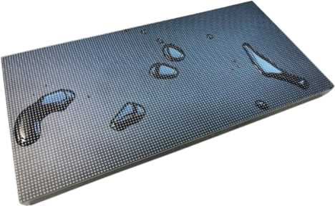

ANTIX
GOB LED
Module
03
PART THREE

Slide 17
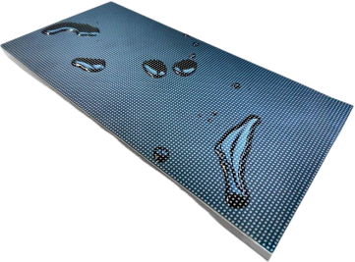
GOB LED Display Module
High Waterproof Level
With the innovative glue-filled seal on the surface of the module. it can well protect the LED on the LED module from water.
Use advanced new material to cover the lamp surface to provide effective protection. the Ultra-high waterproof level is IP68.
03

Slide 18
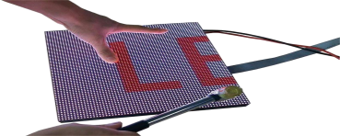
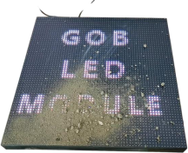
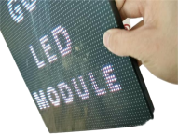
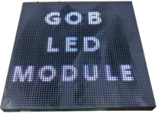
GOB LED Display 03
Module
High Shockproof Level
Special-designing dash-proof glue able to have shock-proof function, offering ultra high protection for LEDs in the various impacts.
High Dust-Proof Level
With high sealing performance of new material , the GOB LED screen panel is totally dust-free with excellent clarity,
and offers excellent visual effecrt with high refresh rate and uniformity color.

Slide 19
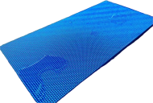
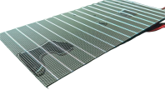
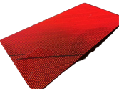

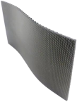

GOB LED Display 03
Module
Excellent Visual Performance
The new material glue does not only has ultra- high transparency but also has excellent thermal conductivity.
Compared with traditional LED modules . GOB LED modules can also provide lifelike colors and a visual appearance.
Can Used for Flexible LED Panel
GOB technology can not only be used for traditional LED display modules but also can be applied to the LED soft module.
This feature can perfectly protect soft LEDs as soft LED panels don’t have masks.

Slide 20







320x160mm Series GOB LED Screen Panel 03
Model | LED Type | Module Size （MM） | Module Resolution | Driving Mode | Refresh Rate(Hz) | Brightness(Nits)
P1.25 | SMD1010 (Black LED) | 320*160 | 256*128 | 1/32 | 3840 | 600
P1.53 | SMD1212 (Black LED) | 320*160 | 208*104 | 1/26 | 3840 | 600
P1.86 | SMD1515 (Black LED) | 320*160 | 172*86 | 1/43 | 3840 | 600
P2 | SMD1515 (Black LED) | 320*160 | 160*80 | 1/40 | 3840 | 700
P2.5 | SMD2020 (Black LED) | 320*160 | 128*64 | 1/32 | 3840 | 800
P3.076 | SMD2020 (Black LED) | 320*160 | 104*52 | 1/26 | 3840 | 800

Slide 21
250x250mm Series GOB LED Display Panel 03
Model | LED Type | Module Size （MM） | Module Resolution | Driving Mode | Refresh Rate(Hz) | Brightness(Nits)
P1.56 | SMD1212 (Black LED) | 250*250 | 160*160 | 1/40 | 3840 | 750
P1.95 | SMD1515 (Black LED) | 250*250 | 128*128 | 1/32 | 3840 | 800
P2.5 | SMD1515 (Black LED) | 250*250 | 100*100 | 1/25 | 3840 | 800
P2.6 | SMD1515 (Black LED) | 250*250 | 96*96 | 1/32 | 3840 | 750

Slide 22
Other Series GOB LED Screen Module 03
Model | LED Type | Module Size （MM） | Module Resolution | Driving Mode | Refresh Rate(Hz) | Brightness(Nits)
P2 | SMD1515 (Black LED) | 256*128 | 128*64 | 1/32 | 3840 | 800
P2.5 | SMD2020 (Black LED) | 160*160 | 64*64 | 1/32 | 3840 | 800
P3 | SMD2020 (Black LED) | 192* 192 | 64*64 | 1/32 | 3840 | 700

Slide 23
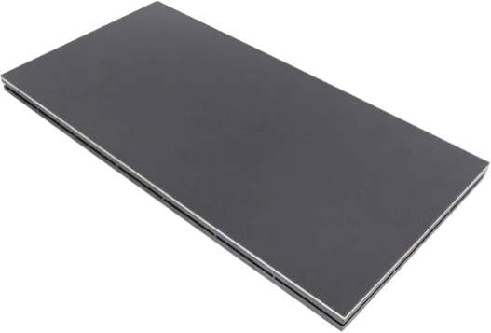
ANTIX
COB LED
Module
04
PART FOUR

Slide 24
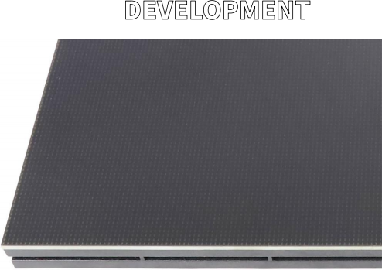
COB LED Display Module 04
COB LED display module, as an LED module using
COB (Chip on Board) packaging technology, has 发展规划
greater advantages in display effect , stability and protection . The LED screen displays more delicate pictures . For example , COB display used for high- end conference room display, when watching high- definition images at close range , the picture is still clear and smooth.

Slide 25
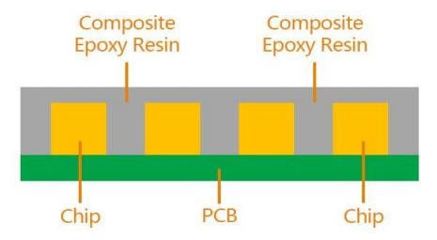
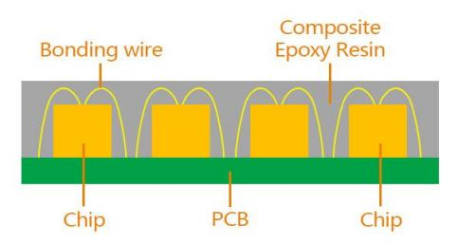
COB Packaging Technology 04
Flip-chip COB
Front-mounted COB
Unlike traditional SMD surface-mount packaging, COB packaging technology integrates light-emitting chips into PCB
boards instead of soldering them one by one on PCB. This packaging method not only simplifies the production
process, but also significantly improves the overall performance of the display. COB packaging technology is generally
divided into COB flip-chip and COB front-mount. Compared with traditional front-mount technology, COB flip-chip
presents unique characteristics in appearance, size, heat dissipation performance, etc.

Slide 26
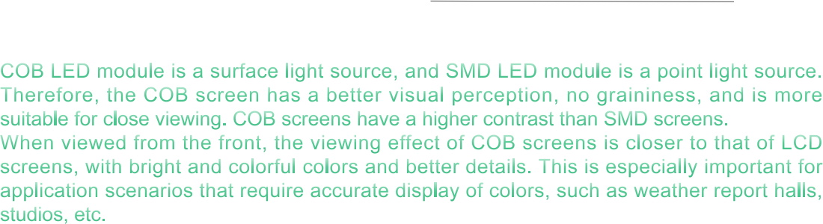
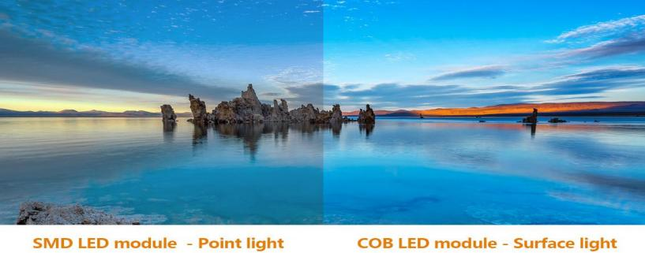
Excellent Display Effect 04

Slide 27
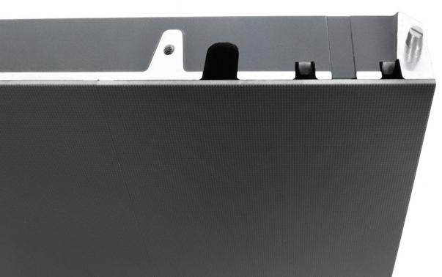
Stability and Protection 04
COB technology significantly reduces the package size of LED modules . This not only improves the overall performance and reliability of LED displays, but also makes LED displays lighter, easier to install and maintain.
COB LED modules have a higher protection level, good waterproof and moisture-proof performance, and a smooth and hard surface , which is anti- collision and anti-bump.

Slide 28
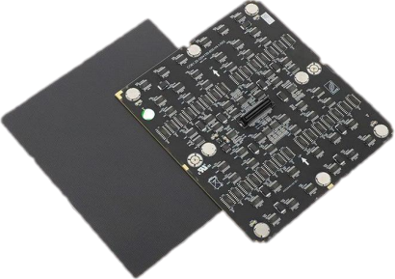
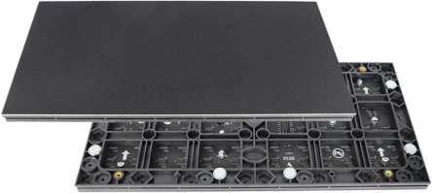
High Definition 04
COB LED modules do not have the lamp bead structure in traditional SMD packages, achieving smaller pixel pitch. The pixel pitch of COB display screens is usually below 2.0mm, such as P0.62, P0.78, P0.93, P1.25, and P1.53, which has incomparable advantages in the field of ultra-high-definition display. Smaller dot pitch means higher pixel density and finer image performance, which can meet the audience’s demand for high-definition picture quality.

Slide 29


320x160mm Series COB LED Display Module 04
Model | LED Type | Module Size （MM） | Module Resolution | Driving Mode | Refresh Rate(Hz) | Brightness(Nits)
P1.25 | Flip chip COB | 320*160 | 256*128 | 1/64 | 3840 | 600
P1.53 | Flip chip COB | 320*160 | 208*104 | 1/52 | 3840 | 600
P1.86 | Flip chip COB | 320*160 | 172*86 | 1/43 | 3840 | 600

Slide 30
150×168.75mm Series COB LED Display Module 04
Model | LED Type | Module Size （MM） | Module Resolution | Driving Mode | Refresh Rate(Hz) | Brightness(Nits)
P0.62 | Flip chip COB | 150*168.75 | 242*272 | 1/64 | 3840 | 500-800
P0.78 | Flip chip COB | 150*168.75 | 192*216 | 1/64 | 3840 | 500-800
P0.93 | Flip chip COB | 150*168.75 | 160*180 | 1/60 | 3840 | 500-800
P1.25 | Flip chip COB | 150*168.75 | 120*135 | 1/60 | 3840 | 500-800
P1.56 | Flip chip COB | 150*168.75 | 96*108 | 1/54 | 3840 | 500-800
P1.87 | Flip chip COB | 150*168.75 | 80*90 | 1/45 | 3840 | 500-800

Slide 31
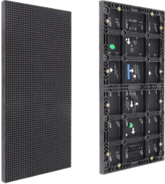
ANTIX
Indoor LED
Module
05
PART F VE

Slide 32
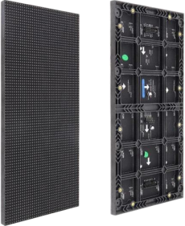
Indoor LED Display Module 05
High Refresh rate indoor LED Screen Panel , High quality full color SMD indoor LED display module Including the Data Power Cables and 2 Years Warranty,
All LED modules With Best Contrast and Color uniformity to ensure the LED display has excellent visual effect.
发展规划
DEV飞OPMENT

Slide 33
Indoor LED Screen Panel 05
For indoor LED display
modules, we choose High-
Quality
Nationstar/Kinglight/Hongs
en LEDs from LED Lamps
Factory directly which have
high color contrast and
best color uniformity so as
to meet the need for high
grayscale and keeping
natural color.
7 2 Hours agi ng test (white balance aging (2×24 hours) and video aging ( 2 4 hours ) ) to improve the reliability the indoor LED display modules and ensure the LED modules without broken leds.
Eagerled Indoor LED
display Panel has all pixel
available from P2mm,
P2.5mm, P3mm,
P3.91mm, P4mm,
P4.81mm, P5mm, P6mm,
P7.72mm, P10mm and
small pixel series such as
P1.875mm , P1.25mm,
P1.538mm, P1.667mm,
P1.86mm, etc
To achieve the best visual pe rfo r ma n ce of L i n s n indoor LED display panel , we use the best Driving IC, such as MIB5153,MBI5124, ICN2153 , ICN2038S with high refresh rate and high grey level with the latest technologies.
LED Lamps
IC Driver
72+ Hours Aging Tests
Various Pixel Pitch Avaliable

Slide 34
320x160mm Series Indoor LED Module 05
Model | LED Type | Module Size （MM） | Module Resolution | Driving Mode | Refresh Rate(Hz) | Brightness(Nits)
P1.25 | SMD1010 | 320*160 | 256*128 | 1/64 | 3840 | 600
P1.53 | SMD1212 | 320*160 | 208*104 | 1/52 | 3840 | 600
P1.86 | SMD1515 | 320*160 | 172*86 | 1/43 | 3840 | 600
P2 | SMD1515 | 320*160 | 160*80 | 1/40 | 3840 | 700
P2.5 | SMD2020 | 320*160 | 128*64 | 1/32 | 3840 | 800
P3.076 | SMD2020 | 320*160 | 104*52 | 1/26 | 3840 | 800
P4 | SMD2020 | 320*160 | 80*40 | 1/20 | 3840 | 700

Slide 35


250x250mm Series Cable Connection 05
Indoor LED Module
Model | LED Type | Module Size （MM） | Module Resolution | Driving Mode | Refresh Rate(Hz) | Brightness(Nits)
P1.56 GOB | SMD1212 | 250*250 | 160*160 | 1/40 | 3840 | 750
P1.95 GOB | SMD1515 | 250*250 | 128*128 | 1/32 | 3840 | 800
P2.6 GOB | SMD1515 | 250*250 | 96*96 | 1/32 | 3840 | 750
P2.97 | SMD2020 | 250*250 | 84*84 | 1/28 | 3840 | 800
P3.91 | SMD2020 | 250*250 | 64*64 | 1/ 16 | 3840 | 800

Slide 36
250x250mm Series Hub Connection Indoor 05
LED Module
Model | LED Type | Module Size （MM） | Module Resolution | Driving Mode | Refresh Rate(Hz) | Brightness(Nits)
P1.56 GOB | SMD1212 | 250*250 | 160*160 | 1/40 | 3840 | 750
P1.95 GOB | SMD1515 | 250*250 | 128*128 | 1/32 | 3840 | 800
P2.6 GOB | SMD1515 | 250*250 | 96*96 | 1/32 | 3840 | 750
P2.97 | SMD2020 | 250*250 | 84*84 | 1/28 | 3840 | 800
P3.91 | SMD2020 | 250*250 | 64*64 | 1/ 16 | 3840 | 700

Slide 37
250x250mm Series Hub Connection Indoor 05 Flexible LED Module
Model | LED Type | Module Size （MM） | Module Resolution | Driving Mode | Refresh Rate(Hz) | Brightness(Nits)
P1.95 GOB | SMD1515 | 250*250 | 128*128 | 1/32 | 3840 | 800
P2.6 GOB | SMD1515 | 250*250 | 96*96 | 1/32 | 3840 | 750
P2.97 | SMD2020 | 250*250 | 84*84 | 1/28 | 3840 | 800
P3.91 | SMD2020 | 250*250 | 64*64 | 1/ 16 | 3840 | 700

Slide 38







Other Series Hub Connection Indoor LED Module 05
Model | LED Type | Module Size （MM） | Module Resolution | Driving Mode | Refresh Rate(Hz) | Brightness(Nits)
P0.93 | MiniLED | 300*168.75 | 320*180 | 1/60 | 3840 | 300-800
P1.25 | SMD1010 | 300*168.75 | 240*135 | 1/60 | 3840 | 300-800
P1.56 | SMD1010 | 300*168.75 | 192* 108 | 1/64 | 3840 | 300-800
P1.87 | SMD1515 | 300*168.75 | 160*90 | 1/45 | 3840 | 300-800
P1.25 | SMD1010 | 320*180 | 256*144 | 1/60 | 3840 | 300-800
P1.53 | SMD1010 | 320*180 | 208*116 | 1/60 | 3840 | 300-800
P1.86 | SMD1010 | 320*180 | 172*96 | 1/64 | 3840 | 300-800
P1.25 | SMD1010 | 320*160 | 256*128 | 1/64 | 3840 | 600
P1.53 | SMD1010 | 320*160 | 208*104 | 1/52 | 3840 | 600
P1.86 | SMD1515 | 320*160 | 172*86 | 1/43 | 3840 | 600
P2 | SMD1515 | 320*160 | 160*80 | 1/40 | 3840 | 700
P2.5 | SMD2020 | 320*160 | 128*64 | 1/32 | 3840 | 800

Slide 39
Other Series Indoor LED Display Modules 05
Model | LED Type | Module Size （MM） | Module Resolution | Driving Mode | Refresh Rate(Hz) | Brightness(Nits)
P2 | SMD1515 | 256*128 | 128*64 | 1/32 | 3840 | 800
P2.5 | SMD2020 | 160*160 | 64*64 | 1/32 | 3840 | 800
P3 | SMD2020 | 192* 192 | 64*64 | 1/32 | 3840 | 700
P4 | SMD2020 | 256*128 | 64*32 | 1/ 16 | 3840 | 800
P4 | SMD2020 | 256*256 | 64*64 | 1/32 | 3840 | 600

Slide 40
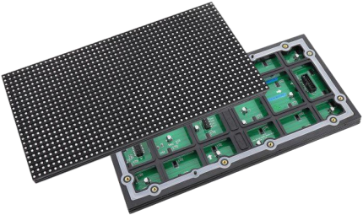
ANTIX
Outdoor
LED Module
06
PART SX

Slide 41

Outdoor LED Display Module 06
High quality full color SMD outdoor LED display module Including the Data Power Cables and 2 Years Warranty.
All LED modules With high brightness and Color uniformity to ensure the LED display has excellent visual effect.
发展规划
DEV飞OPMENT

Slide 42
Outoor LED Screen Panel 06
All pixel available including
P2.5mm,P3mm, P4mm,
P5mm, P3.91mm, P4.81mm,
P5mm, P6mm, P6.67mm,
P8mm, P10mm, and DIP
1R1G1B series such as
P10mm, P16mm, P20mm,
etc. Various sizes
320*160mm, 160mm* 160mm,
192mm* 192mm,250mmx250
mm and 256mm* 128mm are
in stock.
We choose high-
quality LED chips
such as Nationstar,
Kinglight for outdoor
LED display modules.
Furthermore, high
brightness and IP65
waterproof protection
can be provided.
To achieve the best
visual performance of
outdoor LED display, we
use the best driving IC
such as
MBI5153,MBI5124,
ICN2153,ICN2038S
with high refresh rate
and high grey level with
the latest technologies.
7 2 Hours agi ng test (white balance aging (2×24 hours) and video aging ( 2 4 hours ) ) to improve the reliability the outdoor LED display modules and ensure the LED modules without broken leds.
LED Lamps
IC Driver
72+ Hours Aging Tests
Various Pixel Pitch Avaliable

Slide 43
320x160mm Series Outdoor LED Display Module 06
Model | LED Type | Module Size （MM） | Module Resolution | Driving Mode | Refresh Rate(Hz) | Brightness(Nits)
P2.5 | SMD1415 | 320*160 | 128*64 | 1/ 16 | 3840 | 5000
P3.076 | SMD1415 | 320*160 | 104*52 | 1/ 13 | 3840 | 5000
P4 | SMD1921 | 320*160 | 80*40 | 1/ 10 | 3840 | 5500
P5 | SMD2727 | 320*160 | 64*32 | 1/8 | 3840 | 5500
P5 | SMD1921 | 320*160 | 64*32 | 1/8 | 3840 | 5500
P6.67 | SMD3535 | 320*160 | 48*24 | 1/6 | 3840 | 6000
P8 | SMD3535 | 320*160 | 40*20 | 1/5 | 3840 | 5500
P10 | SMD3535 | 320*160 | 32* 16 | 1/2 | 3840 | 5800
P10 | DIP346 1R1G1B | 320*160 | 32* 16 | 1/4 | 3840 | 8000

Slide 44







320x160mm with Flexible Mask Series Outdoor 06 LED Display Module
Model | LED Type | Module Size （MM） | Module Resolution | Driving Mode | Refresh Rate(Hz) | Brightness(Nits)
P5 | SMD1921 | 320*160 | 64*32 | 1/8 | 3840 | 6000
P5 | SMD2727 | 320*160 | 64*32 | 1/8 | 3840 | 6000
P6.67 | SMD3535 | 320*160 | 48*24 | 1/6 | 3840 | 6000
P8 | SMD3535 | 320*160 | 40*20 | 1/5 | 3840 | 5500
P10 | SMD3535 | 320*160 | 32* 16 | 1/2 | 3840 | 5800

Slide 45
80x160mm Series Outdoor LED Display Module 06
Model | LED Type | Module Size （MM） | Module Resolution | Driving Mode | Refresh Rate(Hz) | Brightness(Nits)
P4 | SMD1921 | 80*160 | 20*40 | 1/ 10 | 3840 | 5500
P5 | SMD1921 | 80*160 | 16*32 | 1/8 | 3840 | 5500
P6.67 | SMD3535 | 80*160 | 12*24 | 1/6 | 3840 | 5500
P8 | SMD3535 | 80*160 | 10*20 | 1/5 | 3840 | 5500
P10 | SMD3535 | 80*160 | 8*16 | 1/2 | 3840 | 5500

Slide 46
250x250mm Cable Connection Outdoor LED 06 Display Module
Model | LED Type | Module Size （MM） | Module Resolution | Driving Mode | Refresh Rate(Hz) | Brightness(Nits)
P2.6 | SMD1415 | 250*250 | 96*96 | 1/24 | 3840-7680 | 4500
P2.97 | SMD1415 | 250*250 | 84*84 | 1/21 | 3840-7680 | 4500
P3.91 | SMD1921 | 250*250 | 64*64 | 1/8 | 3840-7680 | 6000
P3.91 | SMD1921 (black) | 250*250 | 64*64 | 1/8 | 3840-7680 | 4000

Slide 47
250x250mm Hub Connection Outdoor LED 06 Display Module
Model | LED Type | Module Size （MM） | Module Resolution | Driving Mode | Refresh Rate(Hz) | Brightness(Nits)
P2.6 | SMD1415 | 250*250 | 96*96 | 1/24 | 3840-7680 | 4500
P2.97 | SMD1415 | 250*250 | 84*84 | 1/21 | 3840-7680 | 4500
P3.91 | SMD1921 | 250*250 | 64*64 | 1/ 16 | 3840-7680 | 4800
P3.91 | SMD1921 | 250*250 | 64*64 | 1/8 | 3840-7680 | 6000
P3.91 | SMD1921 (black) | 250*250 | 64*64 | 1/8 | 3840-7680 | 4000

Slide 48
250x250mm Hub Connection Flexible 06
Outdoor LED Display Module
Model | LED Type | Module Size （MM） | Module Resolution | Driving Mode | Refresh Rate(Hz) | Brightness(Nits)
P2.6 | SMD1415 | 250*250 | 96*96 | 1/24 | 3840 | 4500
P2.97 | SMD1415 | 250*250 | 84*84 | 1/21 | 3840 | 4500
P3.91 | SMD1921 | 250*250 | 64*64 | 1/ 16 | 3840 | 4800

Slide 49







288x288mm Hub Connection Outdoor LED 06 Display Module
Model | LED Type | Module Size （MM） | Module Resolution | Driving Mode | Refresh Rate(Hz) | Brightness(Nits)
P3.79 | SMD1921 | 288*288 | 76*76 | 1/ 19 | 3840-7680 | 4500
P4.8 | SMD1921 | 288*288 | 60*60 | 1/ 10 | 3840-7680 | 4500
192x192mm Series Outdoor LED Screen Panel
Model | LED Type | Module Size （MM） | Module Resolution | Driving Mode | Refresh Rate(Hz) | Brightness(Nits)
P3 | SMD1415 | 192* 192 | 64*64 | 1/ 16 | 3840 | 5500
P6 | SMD2727 | 192* 192 | 32*32 | 1/6 | 3840 | 5500
P6 | SMD3535 | 192* 192 | 32*32 | 1/8 | 3840 | 6000

Slide 50
Other Series Outdoor LED Screen Module 06
Model | LED Type | Module Size （MM） | Module Resolution | Driving Mode | Refresh Rate(Hz) | Brightness(Nits)
P2.5 | SMD1415 | 160*160 | 64*64 | 1/ 16 | 3840 | 5000
P4 | SMD1921 | 256*128 | 64*32 | 1/8 | 3840 | 6000
P8 | SMD3535 | 256*128 | 32* 16 | 1/4 | 3840 | 6000
P10 | DIP346 1R1G1B | 160*160 | 16*16 | 1/4 | 1920 | 8000
P16 | DIP346 1R1G1B | 256*256 | 16*16 | 1/ 1 | 1920 | 10000

Slide 51







320×160/80x160mm Energy-saving Series 06
Outdoor LED Display Module
Model | LED Type | Module Size （MM） | Module Resolution | Driving Mode | Refresh Rate(Hz) | Brightness(Nits)
P2.5 | SMD1415 | 320*160 | 128*64 | 1/ 16 | 3840 | 5000
P3.076 | SMD1415 | 320*160 | 104*52 | 1/ 13 | 3840 | 5000
P4 | SMD1921 | 320*160 | 80*40 | 1/ 10 | 3840 | 5000
P5 | SMD1921 | 320*160 | 64*32 | 1/8 | 3840 | 5000
P6.67 | SMD3535 | 320*160 | 48*24 | 1/6 | 3840 | 5500
P8 | SMD3535 | 320*160 | 40*20 | 1/5 | 3840 | 5000
P10 | SMD3535 | 320*160 | 32* 16 | 1/2 | 3840 | 6000
P4 | SMD1921 | 80*160 | 20*40 | 1/ 10 | 3840 | 5500
P5 | SMD1921 | 80*160 | 16*32 | 1/8 | 3840 | 5500
P6.67 | SMD3535 | 80*160 | 12*24 | 1/6 | 3840 | 5500
P8 | SMD3535 | 80*160 | 10*20 | 1/5 | 3840 | 5500
P10 | SMD3535 | 80*160 | 8*16 | 1/2 | 3840 | 5500

Slide 52

ANTIX

